Slide 1





VOLTZIQ
Smart Battery Management Platform
Built for India. Powered by Intelligence.
Smart BMS
Mobile App
Cloud Platform
GPS & IoT
Prepared for EV OEMs | Fleet Operators | Battery Swapping Networks | Investors

Slide 2








THE INDUSTRY CHALLENGE
01 · PROBLEM
Why Traditional BMS Is Not Enough
A BMS that only protects cells — with no visibility, no connectivity, and no intelligence — leaves OEMs and fleets exposed.
No Monitoring
Battery Theft
Manual Service
Poor Battery Health
Zero visibility into battery status once it leaves the factory
No way to detect or prevent unauthorized removal
Technicians must physically inspect every fault
No early warning as cells degrade over time
Unexpected Failures
Costly Downtime
Poor Visibility
Fleet Management Gaps
Problems surface only after the battery has failed
Vehicles sit idle while faults are diagnosed
No data to act on before small issues escalate
No way to track or manage batteries at scale
VOLTZIQ
02

Slide 3





INTRODUCING VOLTZIQ
02 · SOLUTION
One Connected Battery Ecosystem
Every battery, connected — from the cell to the cloud to the fleet manager's dashboard.
Battery
Smart BMS
Bluetooth
4G IoT Gateway
Cloud Platform
Mobile App
Fleet Dashboard
Predictive Maintenance
Real-time visibility
Remote intelligence
Fleet-scale control
See every battery's health, location, and status live
Configure, alert, and predict — without a truck roll
Manage one battery or ten thousand from one screen
VOLTZIQ
03

Slide 4
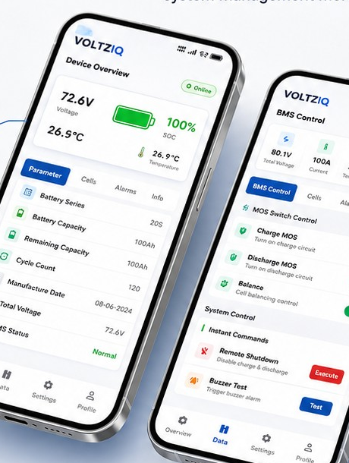








VOLTZIQ MOBILE APP
03 · TECHNOLOGY
Every Battery, Monitored and Controlled from Your Phone
PROBLEM
Fleet teams have no way to check battery status or adjust settings without physically accessing the pack.
HOW IT WORKS
The VoltzIQ app streams live SOC, voltage, current, temperature and per-cell data — and lets you configure charge/discharge MOS and balancing remotely.
WHAT YOU CAN SEE & CONTROL
Battery % / SOC
Voltage & Current
Temperature
Cell Voltages
Cycle Count
Battery Health
Charge / Discharge MOS
Fault Status
BUSINESS VALUE Full battery visibility and remote control — zero truck rolls, faster resolution.
VOLTZIQ
04

Slide 5
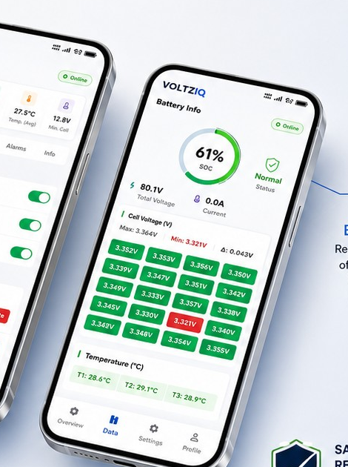
VOLTZIQ MOBILE APP
03 · TECHNOLOGY
Alerts Before Failures. Analytics Before Repeats.
PROBLEM
Faults are discovered only after damage is done, and there's no data trail to prevent the next failure.
HOW IT WORKS
Instant push alerts fire the moment a fault occurs, while continuous SOC/SOH analytics reveal usage patterns and predict failures before they happen.
REAL-TIME ALERTS
High Temperature
Over / Low Voltage
Over Current
Short Circuit
Comm. Failure
Tampering / Removal
BUSINESS VALUE Predict failures before they happen — immediate alerts, data-backed decisions.
VOLTZIQ
05

Slide 6



FLEET COMMAND CENTER
03 · TECHNOLOGY
Manage Thousands of Batteries from One Dashboard
A single pane of glass for every battery, every vehicle, every fleet.
1,240
1,198
42
100%
96.4
7
Total Batteries
Online
Offline
GPS Tracked
Avg. Health Score
Active Faults
TODAY'S FLEET ACTIVITY
Charging
Discharging
Idle
In Trip
62%
81%
34%
71%
GPS FLEET MAP
BUSINESS VALUE Real-time fleet-wide visibility drives faster decisions and higher uptime.
VOLTZIQ
06

Slide 7
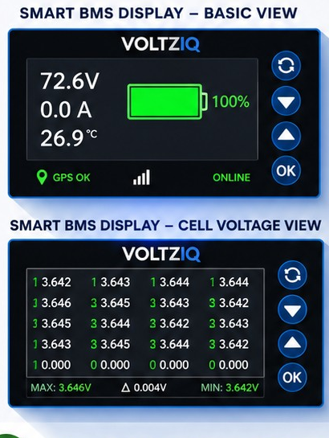
INTEGRATED HARDWARE
03 · TECHNOLOGY
One Device. Display, GPS, and IoT — Built In.
PROBLEM
Traditional setups need a separate GPS antenna, GPS module, and display — more wiring, more cost, more failure points.
HOW IT WORKS
VoltzIQ integrates the display, GPS module, and IoT connectivity into a single smart unit — connected with one cable.
TRADITIONAL VS. VOLTZIQ INTEGRATED
3 separate components
1 integrated device
Complex wiring
Single cable
More failure points
Higher reliability
Higher install time & cost
Plug-and-play, faster production
BUSINESS VALUE Lower BOM, faster production, better reliability — and built-in anti-theft GPS tracking.
VOLTZIQ
07

Slide 8





END-TO-END ARCHITECTURE
03 · TECHNOLOGY
From Battery Cell to Enterprise System
A complete data pipeline connecting hardware, cloud, and every business stakeholder.
Battery
BMS
Bluetooth
IoT Gateway
Cloud
Mobile App
Fleet Portal
API
OEM ERP
Dealer Portal
Service Center
Customer
Remote Diagnostics • OTA Updates • Fault Prediction • Warranty Tracking • Geo-Fencing • Asset Tracking
BUSINESS VALUE One platform, every stakeholder — from the battery cell to the boardroom.
VOLTZIQ
08

Slide 9




WHAT VOLTZIQ DELIVERS
04 · CUSTOMER BENEFITS
Intelligence That Customers Can Feel
Total Visibility
Remote Control
Instant Alerts
Predictive Analytics
Know battery health anytime, anywhere
Configure BMS settings without opening the pack
Get notified before small issues become failures
See problems coming, not just react to them
Fleet-Scale Management
Asset Tracking
Anti-Theft Protection
Plug & Play Hardware
Run thousands of batteries from one dashboard
Know the location of every battery, always
Lock, authenticate, and protect every asset
Faster installation, lower production cost
VOLTZIQ
09

Slide 10





THE ROI CHAIN
05 · BUSINESS VALUE
Connected Intelligence Compounds Into ROI
Every layer of visibility and control drives the next business outcome.
Reduce Service Cost
Increase Battery Life
Reduce Warranty Claims
Increase Fleet Uptime
Reduce Theft
Improve Satisfaction
Increase ROI
30–40%
20–25%
15–20%
Fewer Warranty Claims*
Longer Battery Life*
Higher Fleet Uptime*
*Directional estimates based on connected-BMS industry benchmarks; validate against your fleet data.
VOLTZIQ
10

Slide 11
HEAD-TO-HEAD
06 · WHY VOLTZIQ
Traditional BMS vs. VoltzIQ Smart Platform
Capability | Traditional BMS | VoltzIQ Platform
Bluetooth Monitoring | ✖ | ✔
GPS Tracking | ✖ | ✔
4G IoT Connectivity | ✖ | ✔
OTA Updates | ✖ | ✔
Cloud Platform | ✖ | ✔
Fleet Dashboard | ✖ | ✔
Remote Lock / Anti-Theft | ✖ | ✔
Battery Analytics (SOC/SOH) | ✖ | ✔
Asset Tracking | ✖ | ✔
Real-Time Alerts | ✖ | ✔
Predictive Maintenance | ✖ | ✔
API / ERP Integration | ✖ | ✔
Battery-Swap Support | ✖ | ✔
India-Optimized Design | ✖ | ✔
VOLTZIQ
11

Slide 12

THE FINAL WORD
06 · WHY VOLTZIQ
Why OEMs Choose VoltzIQ
Designed & Engineered for India
Intelligent Smart BMS
Mobile App & Cloud Platform
GPS & IoT Integration
Fleet Management Ready
Battery Anti-Theft Protection
Active Cell Balancing
OTA & Remote Configuration
Lower Warranty Costs
Longer Battery Life
Lower Total Cost of Ownership
VOLTZIQ
12

Slide 13



Thank You
Smarter BMS. Smarter Batteries. Smarter Future.
www.voltziq.com
sales@voltziq.com
+91 00000 00000
EV Manufacturers • Battery Pack Manufacturers • Fleet Operators • Battery Swapping Networks • Investors & Distributors
VOLTZIQ
13

